Slide 1
CSc 453
Semantic Analysis
Saumya Debray
The University of Arizona
Tucson

Slide 2
Need for Semantic Analysis
Not all program properties can be represented using context-free grammars.
  E.g.: “variables must be declared before use” is not a context-free property.
Parsing context-sensitive grammars is expensive.
As a pragmatic measure, compilers combine context-free and context-sensitive checking:
  Context-free parsing used to check “code shape;”
  Additional rules used to check context-sensitive aspects.
CSc 453: Semantic Analysis

Slide 3
Syntax-Directed Translation
Basic Idea:
  Associate information with grammar symbols using attributes.
    An attribute can represent any reasonable aspect of a program, e.g., character string, numerical value, type, memory location, etc.
  Use semantic rules associated with grammar productions to compute attribute values.
A parse tree showing attribute values at each node is called an annotated parse tree.
Implementation: Add code to parser to compute and propagate attribute values.
CSc 453: Semantic Analysis

Slide 4
Example: Attributes for an Identifier
name: character string (from scanner)
scope: global, local, …
  if local: whether or not a formal parameter
type:
  integer
  array:
    no. of dimensions
    upper and lower bound for each dimension
    type of elements
  struct:
    name and type of each field
  function:
    number and type of arguments (in order)
    type of returned value
    entry point in memory
    size of stack frame
…
CSc 453: Semantic Analysis

Slide 5
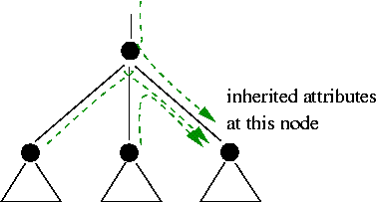
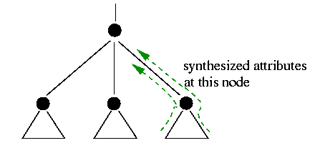
Types of Attributes
Inherited attributes: An attribute is inherited at a parse tree node if its value is computed at a parent or sibling node.
Synthesized attributes: An attribute is synthesized at a parse tree node if its value is computed at that node or one of its children.
CSc 453: Semantic Analysis

Slide 6
Example: A Simple Calculator
Production | Semantic Rule
E → E₁ + E₂ | E.val = E₁.val ⊕E₂.val
E → E₁ * E₂ | E.val = E₁.val ⊗ E₂.val
E → (E₁) | E.val = E₁.val
E → intcon | E.val = intcon.val
CSc 453: Semantic Analysis

Slide 7
Symbol Tables
Purpose: To hold information (i.e., attribute values) about identifiers that get computed at one point and used later.
  E.g.: type information:
    computed during parsing;
    used during type checking, code generation.
Operations:
    create, delete a symbol table;
    insert, lookup an identifier
Typical implementations: linked list, hash table.
CSc 453: Semantic Analysis

Slide 8
Semantic Actions in Yacc
Semantic actions are embedded in RHS of rules.
  An action consists of one or more C statements, enclosed in braces { … }.
Examples:
    ident_decl : ID { symtbl_install( id_name ); }
    type_decl : type { tval = … } id_list;
CSc 453: Semantic Analysis

Slide 9
Semantic Actions in Yacc: cont’d
Each nonterminal can return a value.
  The value returned by the i^{th} symbol on the RHS is denoted by $i.
  An action that occurs in the middle of a rule counts as a “symbol” for this.
  To set the value to be returned by a rule, assign to $$.
    By default, the value returned by a rule is the value of the first RHS symbol, i.e., $1.
CSc 453: Semantic Analysis

Slide 10
Yacc: Declaring Return Value Types
Default return value for symbols is int.
We may want other types of return values, e.g., symbol table pointers, syntax tree nodes.
Declare the various kinds of values that may be returned: %union { symtab_ptr st_ptr; idlist_ptr idents; tree_node tn_ptr; int val; }
Specify return type for each grammar symbol: /* tokens: */ %token <val> INTCON; /* nonterminals: */ %type <st_ptr> ident; %type <tn_ptr> expr;
CSc 453: Semantic Analysis

Slide 11
Semantic Actions in Yacc: Example 1
func : | ¹ type | ² { ret_type = $1; }
 | ³ ID | ⁴ { this_fn = symtbl_install(id_name); }
 | ⁵ ′(′ | ⁶ { scope = LOCAL; }
 | ⁷ formals
 | ⁸ ′)′
 | ⁹ ′{′
 | ¹⁰ decls
 | ¹¹ stmt | ¹² { this_fn→body = $11; }
 | ¹³ ′}′ | ¹⁴ { scope = GLOBAL; }
CSc 453: Semantic Analysis

Slide 12
Semantic Actions in Yacc: Example 2
A simple calculator in Yacc:
E : | E ‘+’ E | { $$ = $1 + $3; }
E : | E ‘*’ E | { $$ = $1 * $3; }
E : | ‘(‘ E ‘)’ | { $$ = $2; }
E : | intcon | { $$ = $1.val; }
CSc 453: Semantic Analysis

Slide 13
Managing Scope Information
When looking up a name in a symbol table, we need to find the “appropriate” declaration.
  The scope rules of the language determine what is “appropriate.”
Often, we want the most deeply nested declaration for a name.
Implementation: for each new scope: push a new symbol table on entry; pop on exit (stack).
  implement symbol table stack as a linked list of symbol tables;
    newly declared identifiers go into the topmost symbol table.
  lookup: search the symbol table stack from the top downwards.
CSc 453: Semantic Analysis

Slide 14
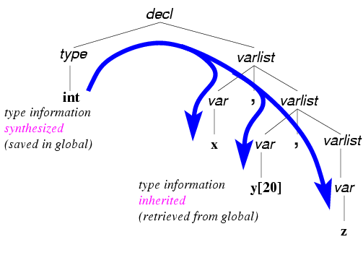
Processing Declarations
Production | Semantic Rule
decl → type varlist ‘;’ | varlist.tval = type.tval;
varlist → var ‘,’ varlist₁ | var.type = varlist.type; varlist₁.type = varlist.type;
xxx : inherited
yyy : synthesized
CSc 453: Semantic Analysis

Slide 15
Processing Declarations: cont’d
decl : type { tval = $1; } varlist ;
varlist : var varlist
| var ;
var : ID opt_subscript { symtbl_insert($1, $2); } ;
CSc 453: Semantic Analysis

Slide 16
Static Checking
Static checking aims to ensure, at compile time, that syntactic and semantic constraints of the source language are obeyed. E.g.:
  Type checks: operators and operands must have compatible types.
  Flow-of-control checks: control transfer statements must have legitimate targets (e.g., break/continue statements).
  Uniqueness checks: a language may dictate unique occurrences in some situations, e.g., variable declarations, case labels in switch statements.
These checks can often be integrated with parsing.
CSc 453: Semantic Analysis

Slide 17
Data Types and Type Checking
A data type is a set of values together with a set of operations that can be performed on them.
Type checking aims to verify that operations in a program code are, in fact, permissible on their operand values.
Reasoning about types:
  The language provides a set of base types and a set of type constructors;
  The compiler uses type expressions to represent types definable by the language.
CSc 453: Semantic Analysis

Slide 18
Type Constructors and Type Expressions
A type expression denotes (i.e., is a syntactic representation of) the type of a program entity:
  A base type is a type expression (e.g., boolean, char, int, float);
  A type name is a type expression;
  A type constructor applied to type expressions is a type expression, e.g.:
    arrays: if T is a type expression then so is array(T);
    records: if T₁, …, T_{n} are type expressions and f₁, …, f_{n} is a list of (unique) identifiers, then record(f₁:T₁, …, f_{n}:T_{n}) is a type expression;
    pointers: if T is a type expression then so is ptr(T);
    functions: if T, T₁, …, T_{n} are type expressions, then so is (T₁, …, T_{n}) → T.
CSc 453: Semantic Analysis

Slide 19
Why use Type Expressions?
char *X; char **f() { X = “GOTCHA!” return &X; } | main() { printf(“%c\n”, (*f())[2]); /* legal??? */ }
  Program Code Type Expression Rule
  f ()→ptr(ptr(char)) symbol table lookup
  f() ptr(ptr(char)) if e : T₁→T₂ and e₁ : T₁ then e(e₁) : T₂
  *f() ptr(char) if e : ptr(T) then *e : T
  *f() array(char) if e : ptr(T) then e : array(T)
  (*f()) array(char) if e : T then (e) : T
  2 int base type
  (*f())[2] char if e₁ : array(T) and e₂ : int then e₁[e₂] : T
What about:
  qsort((void **)lptr,0,k,(int (*)(void*,void*))(num ? ncmp : strcmp));
CSc 453: Semantic Analysis

Slide 20
Notions of Type Equivalence
Name equivalence:
    In some languages (e.g., Pascal), types can be given names.
    Name equivalence views distinct type names as distinct types: two types are name equivalent if and only if they have the same type name.
Structural equivalence:
    Two type expressions are structurally equivalent if they have the same structure, i.e., if both apply the same type constructor to structurally equivalent type expressions.
E.g.: in the Pascal fragment
    type p = ↑node;
    q = ↑node;
    var x : p;
    y : q;
  x and y are structurally equivalent, but not name-equivalent.
CSc 453: Semantic Analysis

Slide 21
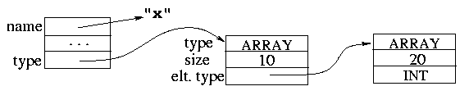
Representing Type Expressions
Type graphs: A graph-structured representation of type expressions:
  Basic types are given predefined “internal values”;
  Named types can be represented via pointers into a hash table.
  A composite type expression f (T₁,…,T_{n}) is represented as a node identifying the constructor f and with pointers to the nodes for T₁, …, T_{n}.
    E.g.: int x[10][20]:
CSc 453: Semantic Analysis

Slide 22
Type Checking Expressions
Production | Semantic Rule | Yacc Code
E → id | E.type = id.type | { $$ = symtab_lookup(id_name); }
E → intcon | E.type = INTEGER | { $$ = INTEGER; }
E → E₁ + E₂ | E.type = result_type(E₁.type, E₂.type) | { $$ = result_type($1, $3); }
/* arithmetic type conversions */ Type result_type(Type t1, Type t2) { if (t1 == error || t2 == error) return error; if (t1 == t2) return t1; if (t1 == double || t2 == double) return double; if (t1 == float || t2 == float) return float; … } | Return types: currently: the type of the expression down the road: type location code to evaluate the expression
CSc 453: Semantic Analysis

Slide 23
Type Checking Expressions: cont’d
Arrays:
  E → id[ E₁ ] { t₁ = id.type;
  if (t₁ == ARRAY ∧ E₁.type == INTEGER)
  E.type = id.element_type;
  else
  E.type = error;
  }
CSc 453: Semantic Analysis

Slide 24
Type Checking Expressions: cont’d
Function calls:
  E → id ‘(‘ expr_list ‘)’
  { if (id.return_type == VOID)
  E.type = error;
  else if ( chk_arg_types(id, expr_list) ) /* actuals match formals in number, type */
  E.type = id.return_type;
  else
  E.type = error;
  }
CSc 453: Semantic Analysis

Slide 25
Type Checking Statements
Different kinds of statements have different type requirements. E.g.:
  if, while statements may require boolean conditiona;
  LHS of an assignment must be an “l-value”, i.e., something that can be assigned.
  LHS and RHS of an assignment must have “compatible” types. If they are of different types, conversion will be necessary.
CSc 453: Semantic Analysis

Slide 26
Operator Overloading
Overloading refers to the use of the same syntax to refer to different operations, depending on the operand types.
    E.g.: in Java, ‘+’ can refer to integer addition, floating point addition, or string concatenation.
The compiler uses operand type information to resolve the overloading, i.e., figure out which operation is actually referred to.
    If there is insufficient information to resolve overloading, the compiler may give an error.
CSc 453: Semantic Analysis

